Slide 1



S-cube
CHALLENGE: Innosuisse & Startupticker
Empowering Swiss Startups & Investors with AI-Driven Insights

Slide 2



Empowering Swiss Startups & Investors with AI-Driven Insights
Swiss Startups Success
S-cube
Notes:
Ladies & gentlemen,
Today ..(talk big energy).. I want to talk about 'YOU'
Yes, you! Smart people
with innovative ideas who want to solve problems. People like you who want to help others & make the world better.
But great idea, great innovation alone is not fun without FUND.
So we WANT to HELP you, to help others.

Slide 3

Text
Similar Startup Discovery
SQL
Visualization

Slide 4
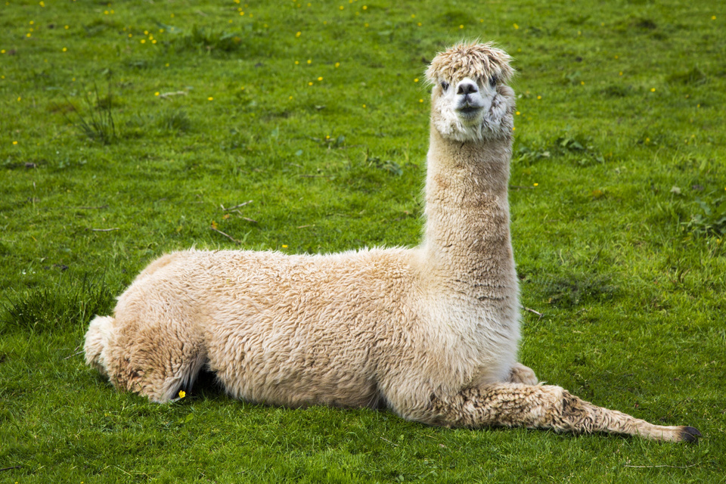


Open source

Slide 5




24%
Notes:
Last year alone, we have HALF a MILLION startups registered, translates into
>40%
data entries compared to the previous year.

Slide 6




Slide 7
10,000+
Local Machine LLM
text embeddings generated

Slide 8
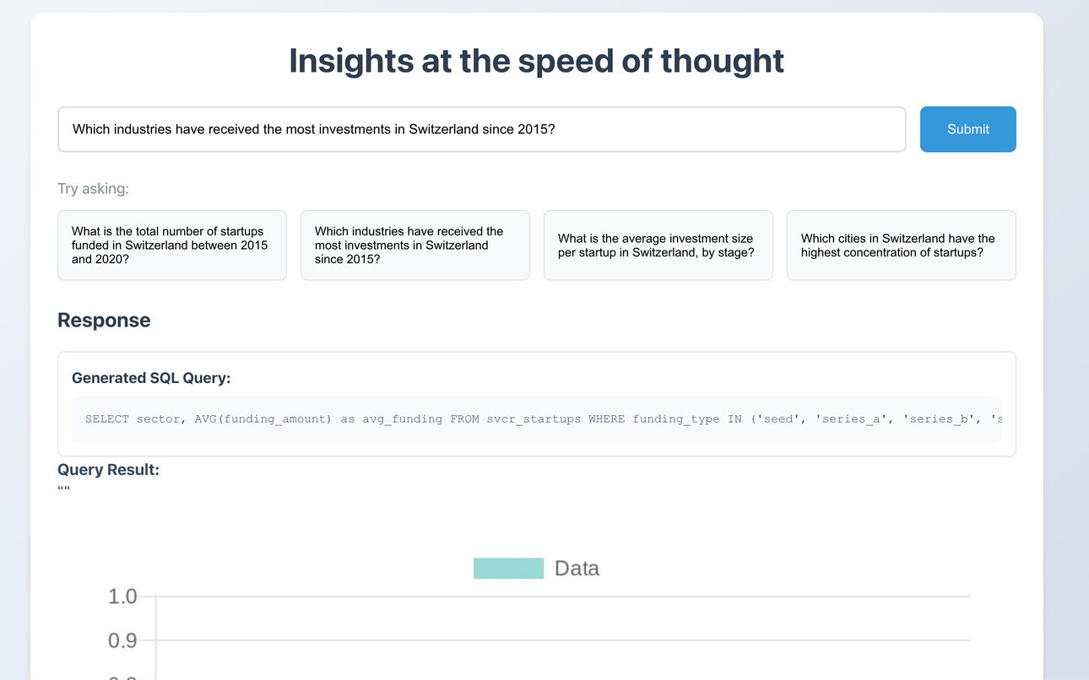
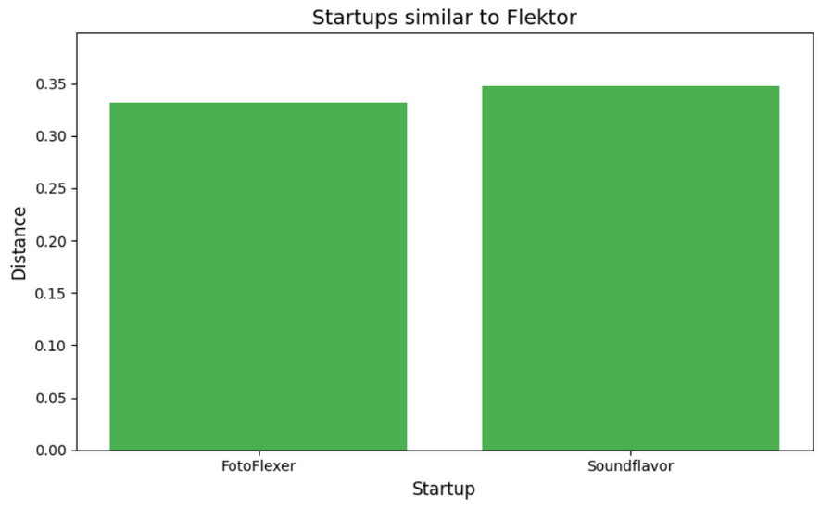
Result
Notes:
We've built an AI-Powered Chatbot Dashboard.
A user-friendly web app where:
Investors & startups can ask questions
and instantly get insights, charts, and comparisons

Slide 9

Dream higher than the
Alps

Slide 10



The S-cube
Ram Kovela
Surya Vedula
Suphawadee Bunthot
MSE, Data Science
Software Engineer
Data Analytics

